Slide 1

URBAN MOBILITY CHALLENGE
Alessandro Borgherini -
Riccardo Rettore - 2110512
Thomas Zamprogno - 2121463

Slide 2
Outline
Introduction & Objectives
Framework
Obstacle avoidance procedure
Trajectory tracking control
State error feedback controller
Linear control
Nonlinear control
Output error feedback controller
B-point control
Further derivatives control
Parking
Cartesian regulation
Posture regulation

Slide 3
Introduction: the "urban mobility challenge"
Problem: An autonomous guided vehicle (AGV) has to travel along a closed circuit avoiding the other AGVs that are parked along the path; at the completion of one lap, the AGV has to get off the circuit and park at the box
PROJECT OBJECTIVES:
Track a closed-loop trajectory
Avoid obstacles on the trajectory
After performing one lap, reach an empty parking lot
PROPOSED SOLUTIONS:
State & output error feedback
Sensor for obstacle detection and avoidance
Cartesian & Posture regulation

Slide 4
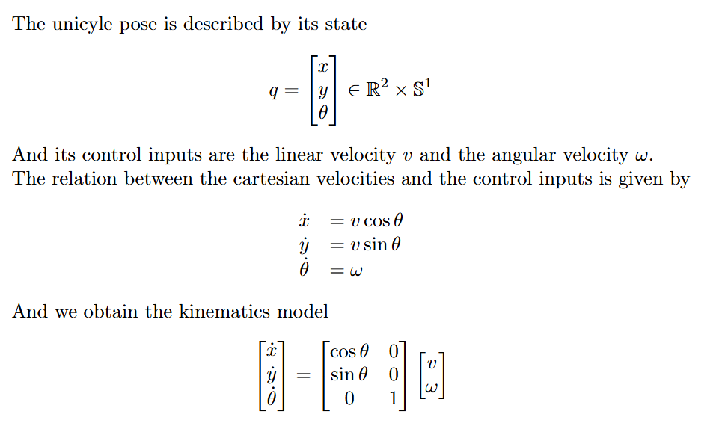
Framework: unicycle
θ
y
x

Slide 5
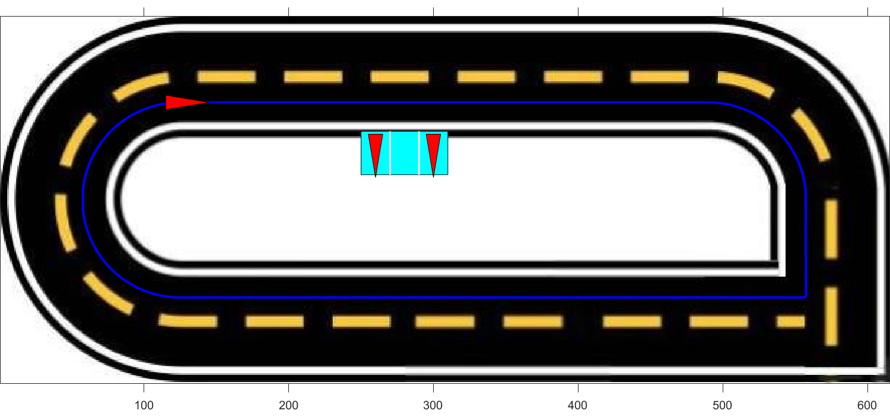
Framework: trajectory
To design the desired trajectory, a series of waypoints was defined. These waypoints were then interpolated using cubic spline interpolation to ensure a continuous path
To test controllers' functionalities on a non-continuous path, a sharp square-angle turn is added to the path

Slide 6
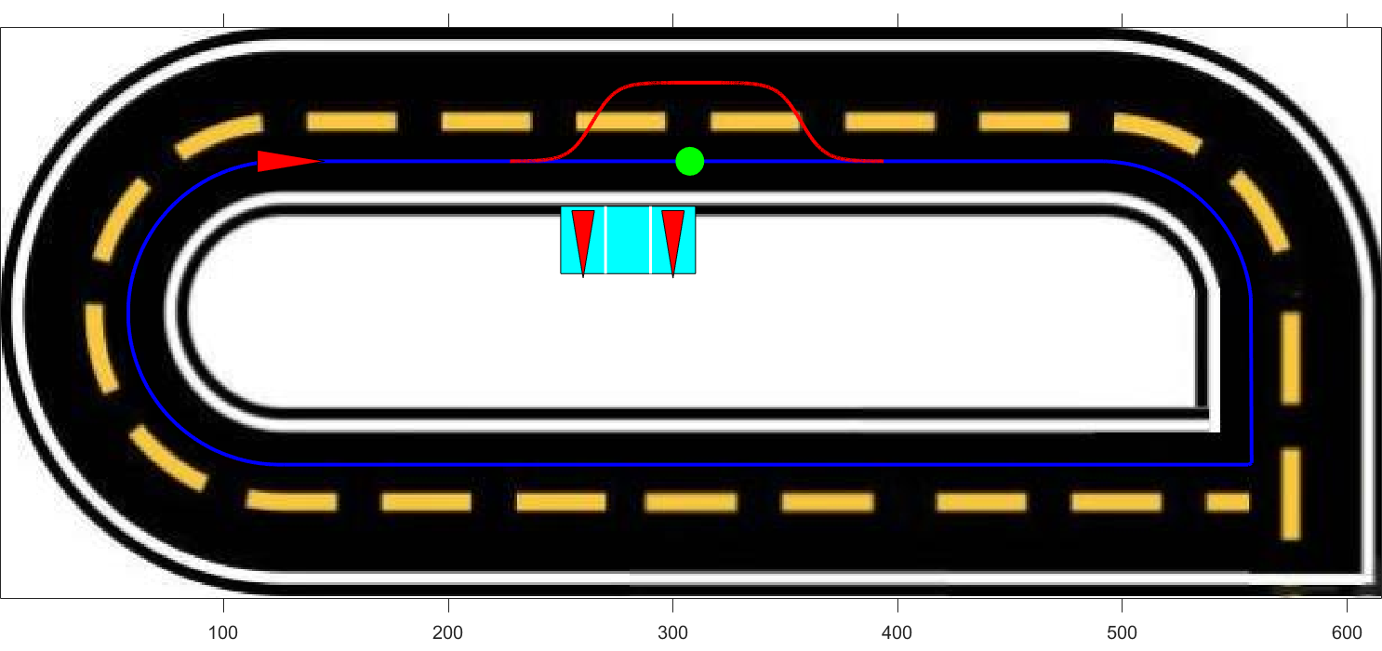
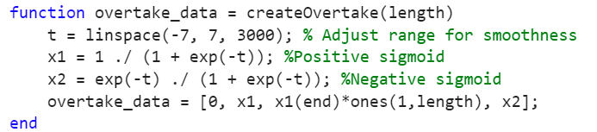
Obstacle avoidance
The unicyle after detecting the obstacle progressively reaches the second lane, after overtaking the obstacle it progressively returns to the first lane
To ensure a smooth and continuous trajectory during the changing lane procedure a sigmoid function has been used

Slide 7
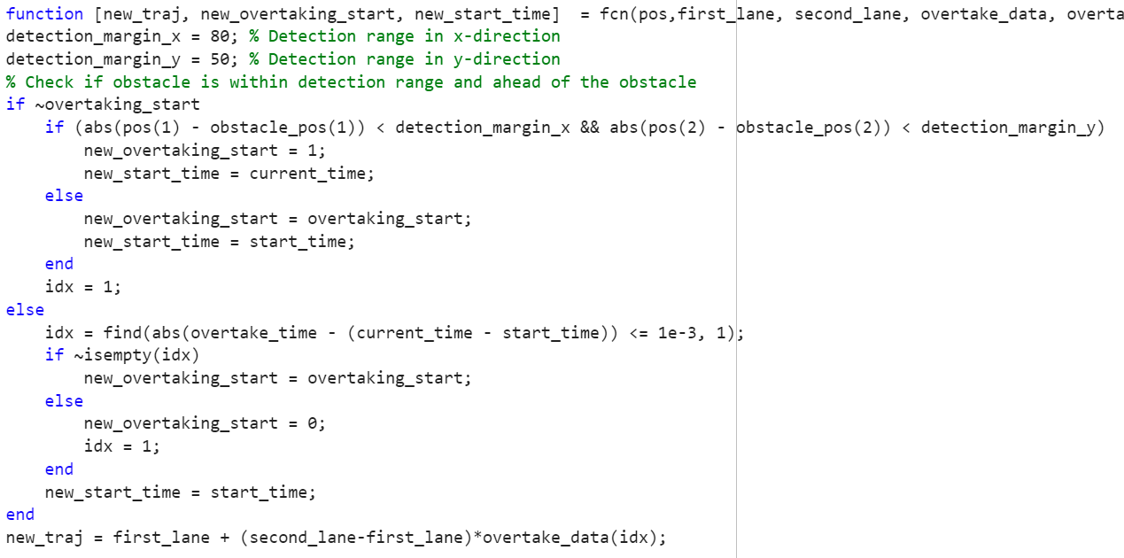
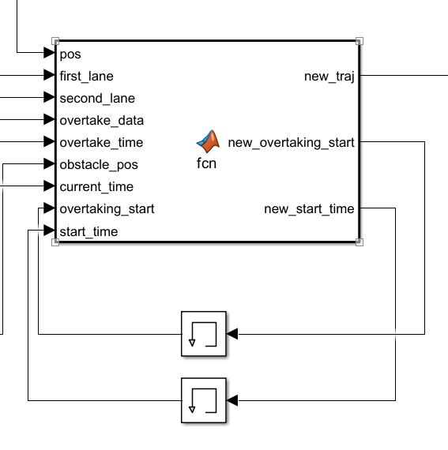
Obstacle avoidance

Slide 8
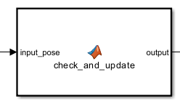
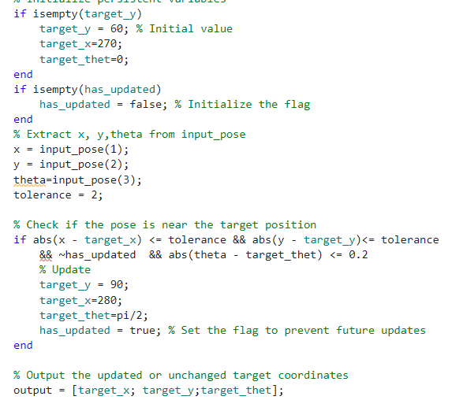
Parking problem
Two waypoints for the parking
Simulate a real parking condition

Slide 9
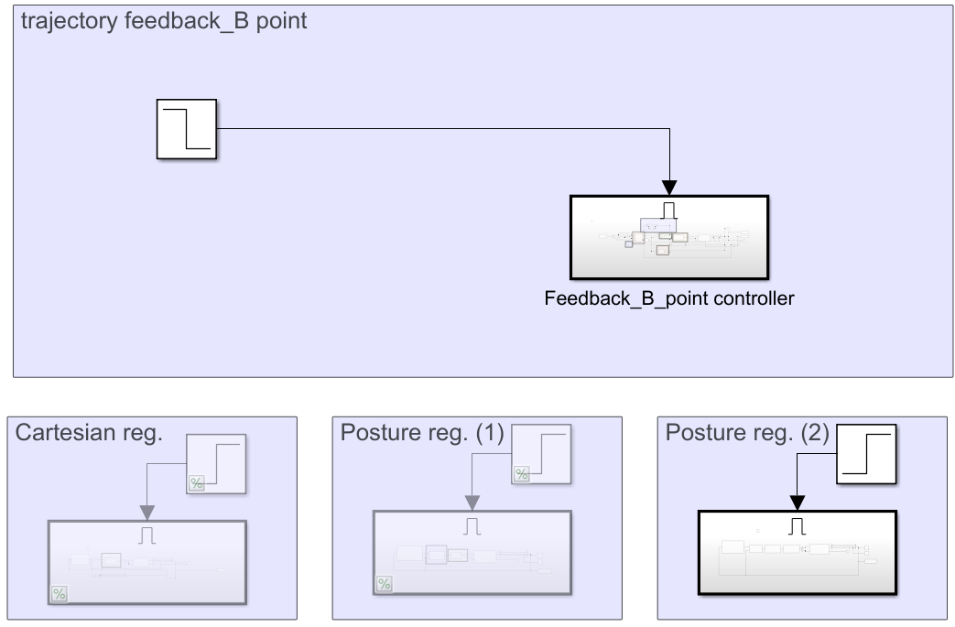
Merger between the tracking trajectory and the parking
Enable to activate individual phases
Automatic switching

Slide 10
TRAJECTORY TRACKING - STATE ERROR FEEDBACK

Slide 11
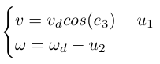
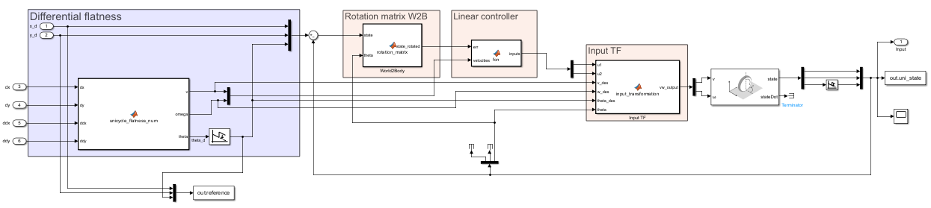
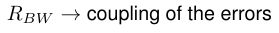
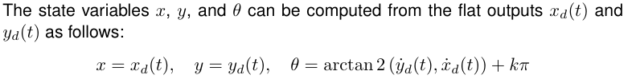
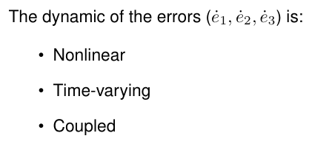
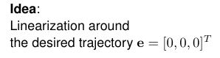
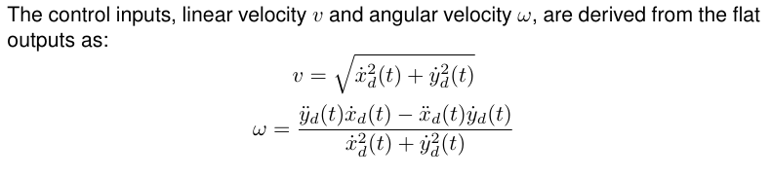
Linear Control
Notes:
THINGS TO SAY:
General overview of the structure
Say that Sigma linear asymp stable → we can only conclude that Sigma NL loc AS
Vdes != 0 , so persistent trajectory (even more important later on with k2 (v is at the denom)
w depends on v^2 basically, so we must have v !=0, furthermore later on , k2=num/vd so vd!=0 otherwise k2 explodes, we will add a saturation on it
explain the wrap / unwrap:
we used the unwrap to normalize theta angle, so we don't have the discontinuity going from 2pi to 0

Slide 12
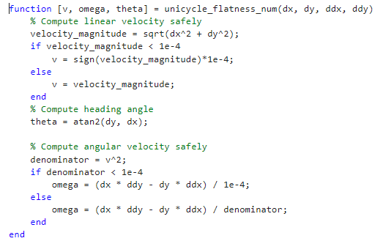
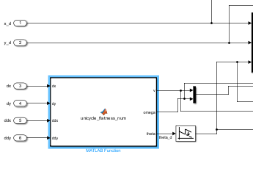
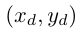
Differential Flatness
Avoiding division by zero
differential flatness block
must be twice differentiable
and feasible for the unicycle
according to the unicycle kinematics
! Constraints on the trajectory !

Slide 13
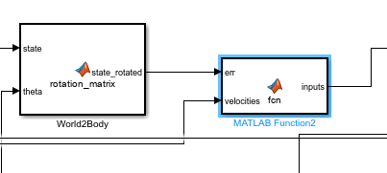
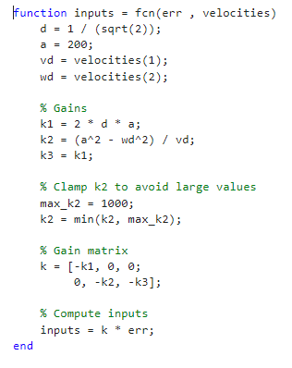
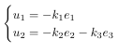
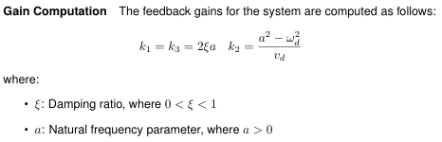
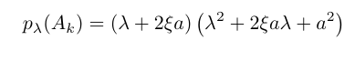
Controller design
persistent trajectories
TI
TV
no guarantee of asymptotic stability,
only for rectilinear and circular motion
saturation
Notes:
K1=k3 TI , k2 TV
linear controller so based on Eigs allocation
We can not guarantee asymp convergence cause K2 (system) TV, but we do have convergence property cause we are doing rectilinear and semicircular motions so someway we are covered by good convergence properties
Say something about eigenvalues, thanks to this ki we know the eigs are on the LHS

Slide 14
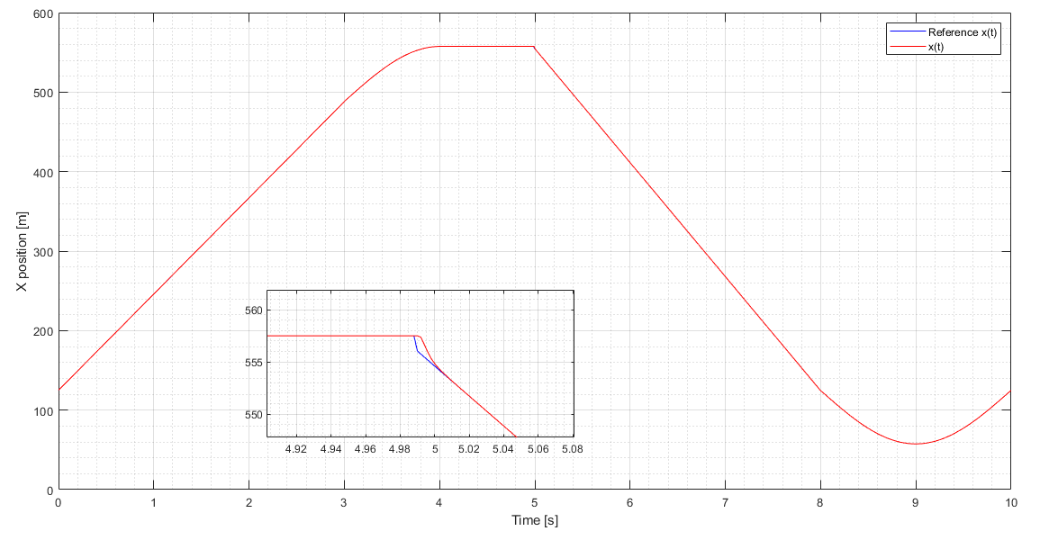
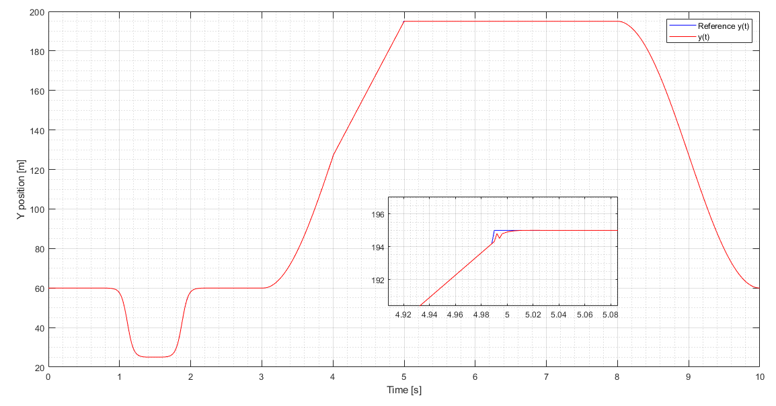
Plots
X TRACKING
Y TRACKING

Slide 15
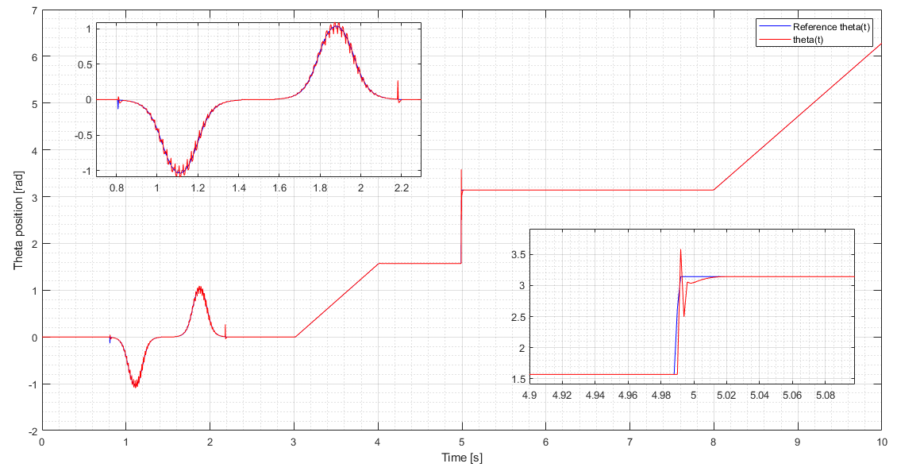

Slide 16
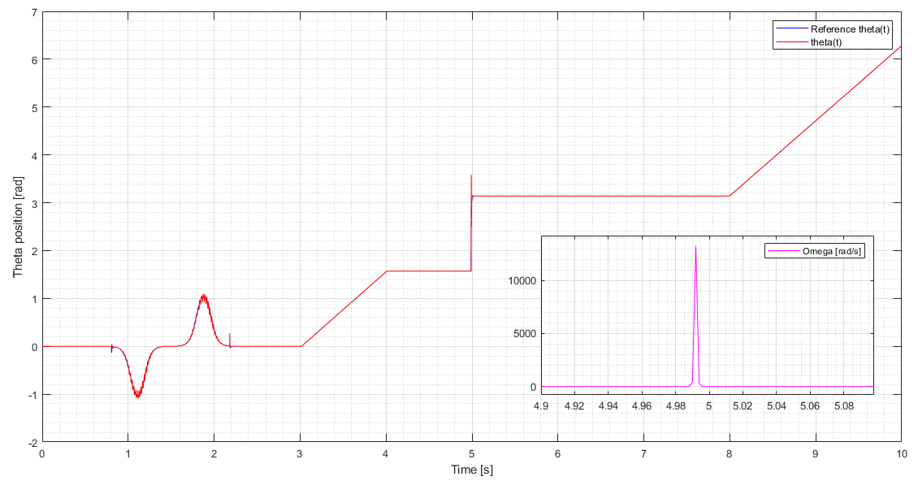
FOCUS ON SQUARE CORNER
Notes:
differential flatness block should not be able to compute the input velocities when reaching a non differentiable part of the trajectory. Indeed, impulses in both velocities arises, with stronger effect in omega, (its computation is based on the second order derivative).
Nonetheless, thanks to saturator blocks on omega and gains we are able to overcome the problem and to finish the simulation anyway.

Slide 17
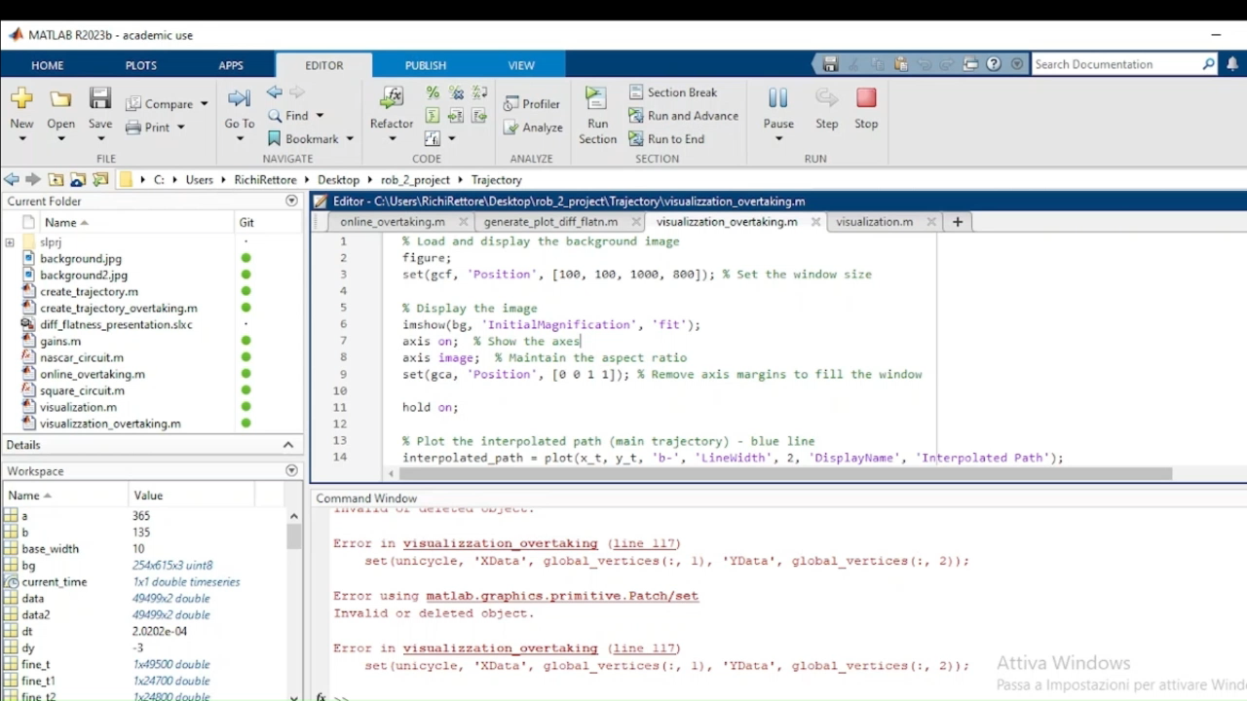

Slide 18
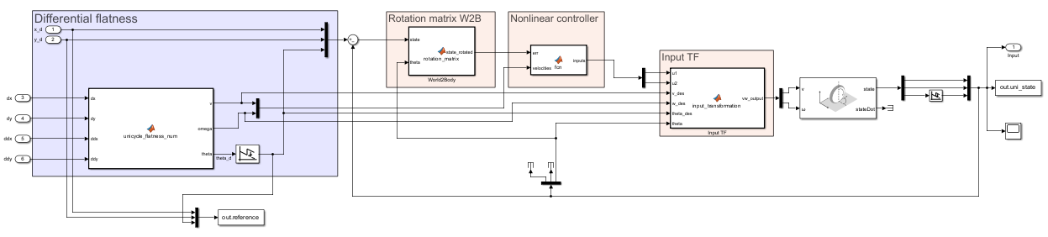
Nonlinear Control
dynamic of the errors is in mixed form
Notes:
THINGS TO SAY:
General overview of the structure and vdes!=0 → same as before cause its related with diff flatness
Highlights the same nature of the structure, with the only difference : gain computation and feedback law
Controller based on Lyap arguments and not eigs allocation
Barbalat’s lemma problem. Before we had no convergence guarantees cause k2 TV , now instead we could end up with loosing conv property cause w could become unbounded and hence Barb no true anymore -→ this is what we stress out in the sharp curve
explain the wrap / unwrap:
we used the unwrap to normalize theta angle, so we don't have the discontinuity going from 2pi to 0

Slide 19
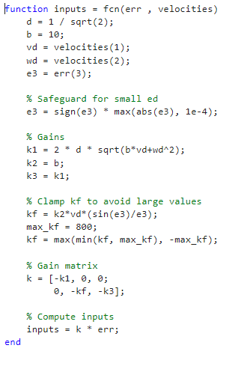
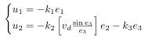
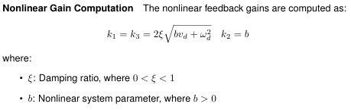
Controller design
nonlinear term
no more singularity in vd=0
TV
TI
resembles k2 of the linear controller
controller stabilizes the error dynamics with global asymptotic stability,
(linear control → only local)
assuming (vd,wd) bounded with bounded derivatives
and (vd,wd) do not go concurrently to zero
square curve
Notes:
Global asymp stab: This is proved using barbalet → we get only e1 , e3 →0 but e2 coupled so also e2→0
Highlight the relation between a and b , could we also compute eigs for this ? Is b a natural freq too ?

Slide 20
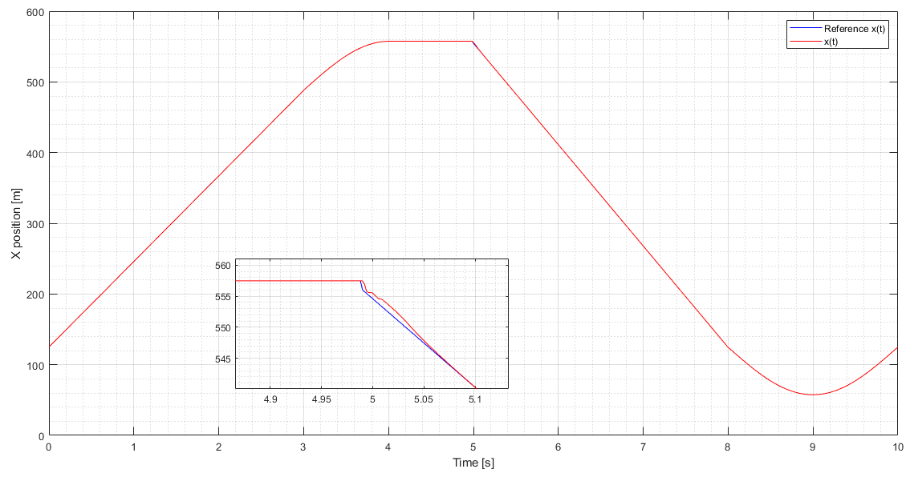
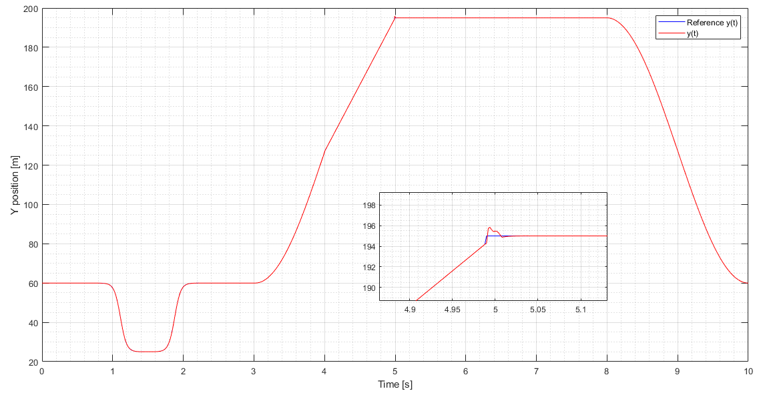
X TRACKING
Y TRACKING

Slide 21
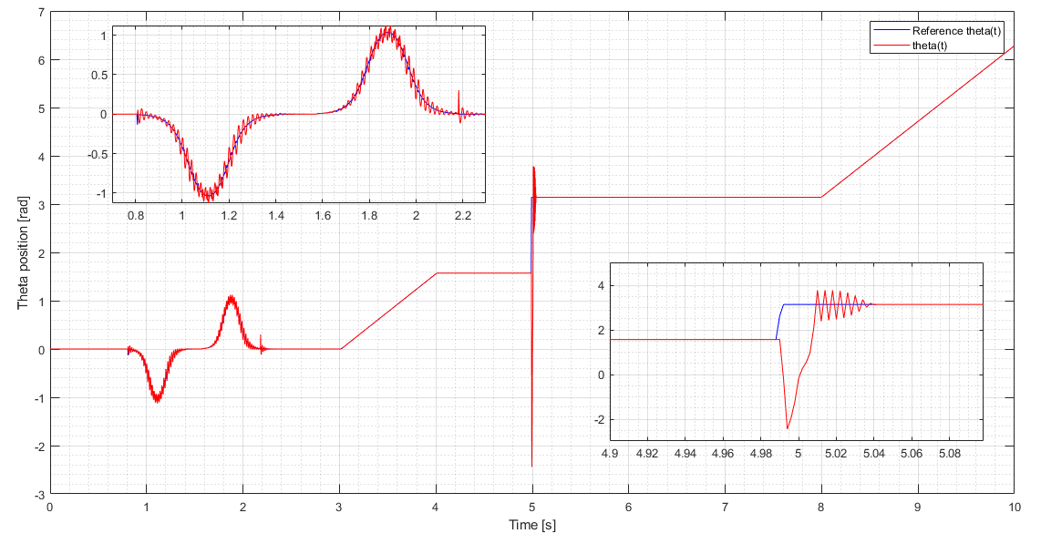
Notes:
Plots --> see if impulse bigger than linear case follows some theoretical thing or just related to gains tuning

Slide 22
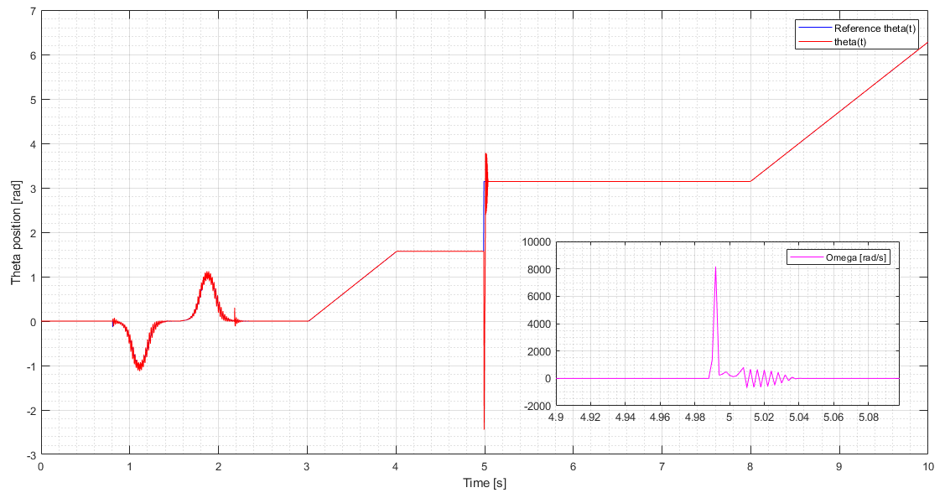
FOCUS ON SQUARE CORNER
Notes:
Focus on sharp curve
Make a consideration regarding NL more enhanced wrt lineare case, maybe theres a reason

Slide 23
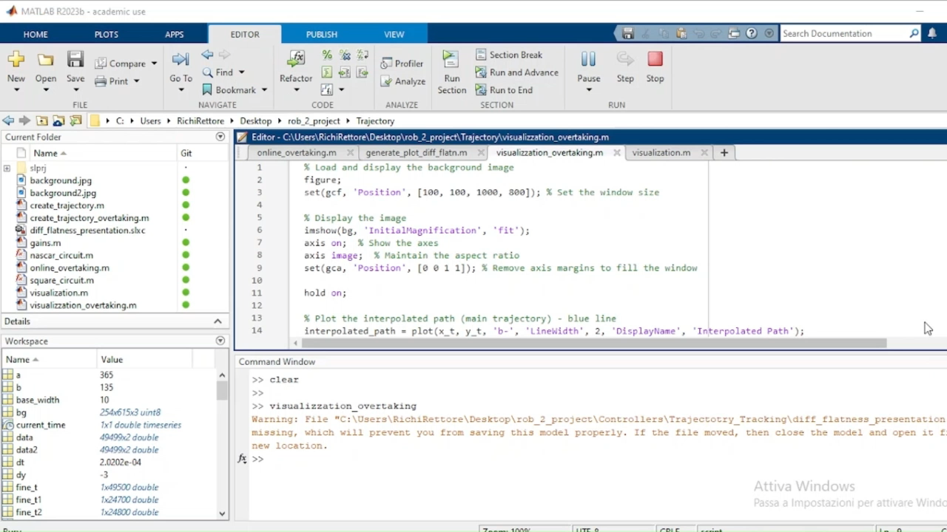

Slide 24
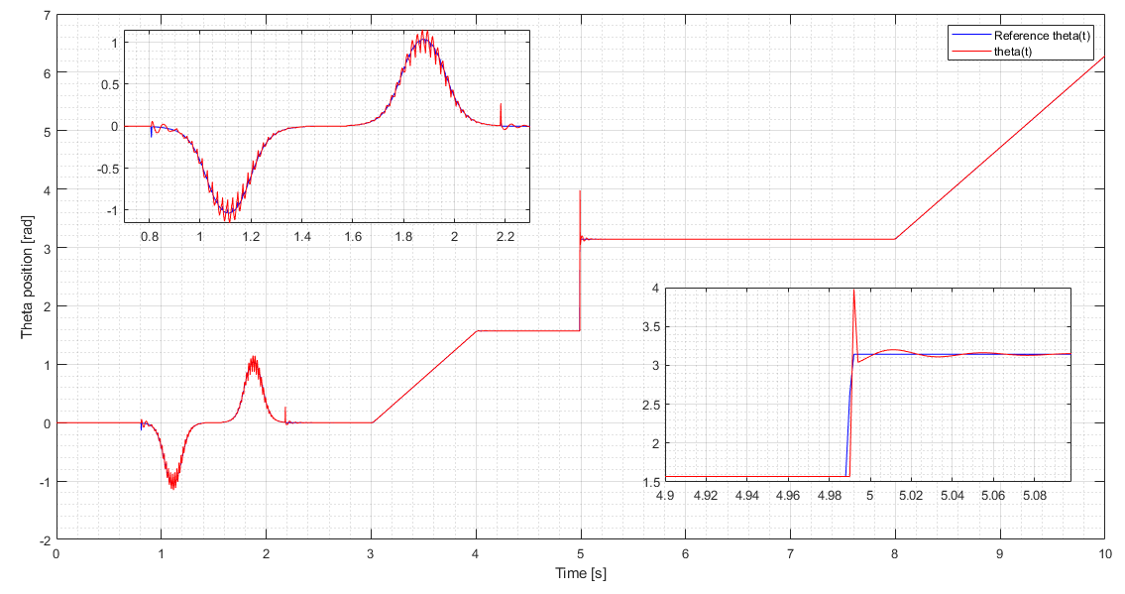
changing desired dumping and b:
d = 2 / sqrt(2)
b =1
Less aggressive , more stable
Notes:
So less aggressive, less reactive , more stable

Slide 25
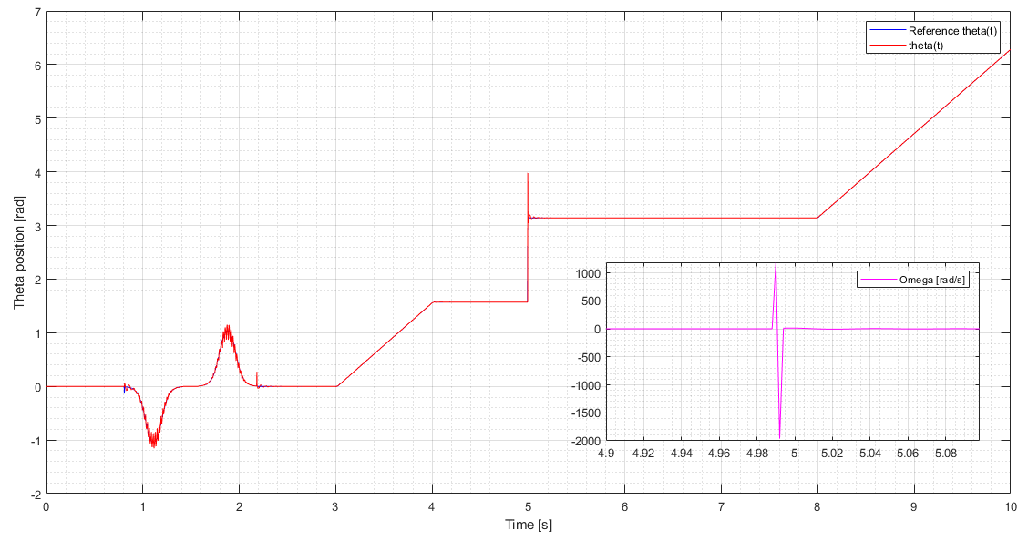
d = 2 / sqrt(2)
b =1

Slide 26
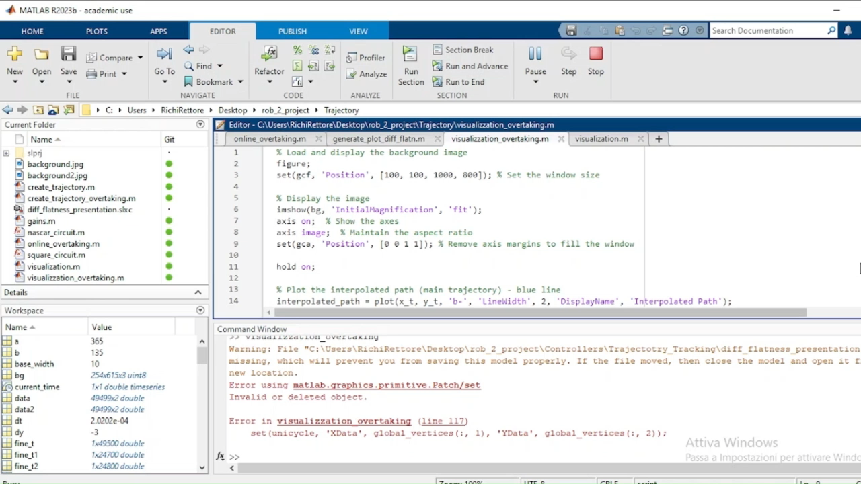

Slide 27
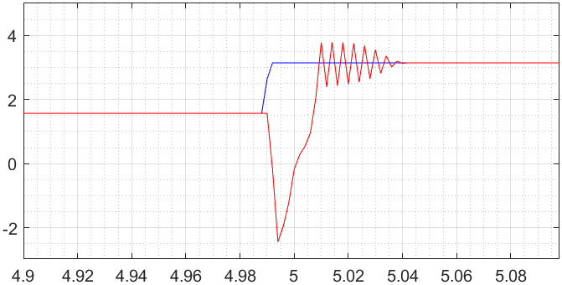
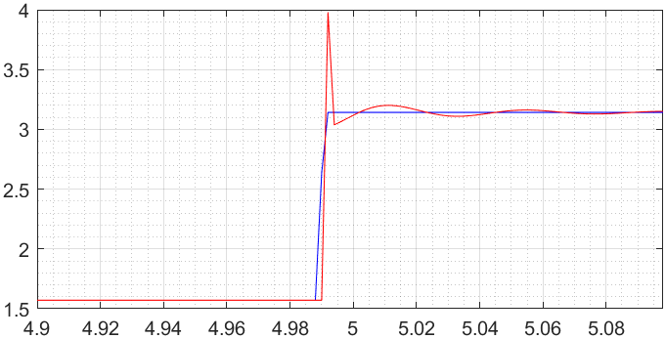
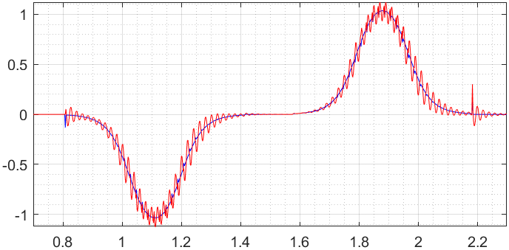
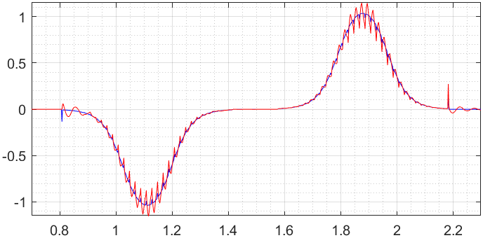
d = 1 / sqrt(2)
b =10
d = 2 / sqrt(2)
b =1
d = 1 / sqrt(2)
b =10
d = 2 / sqrt(2)
b =1
Notes:
Left: More aggressive , more reactive
Right: less aggressive , less reactive but more stable

Slide 28
TRAJECTORY TRACKING - OUTPUT ERROR FEEDBACK

Slide 29
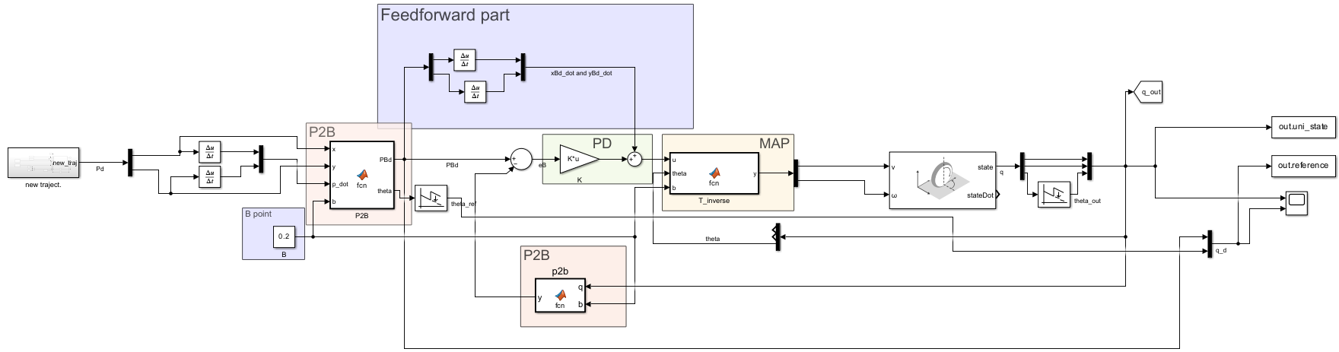
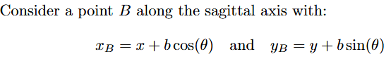
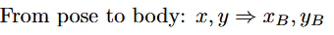
Feedback linearization based on a reference point on the sagittal axis

Slide 30
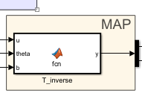
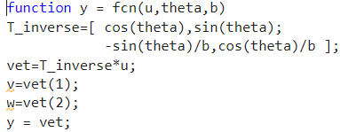



Map
Notes:
B need to be different from 0

Slide 31




Controller design
Pro:

Slide 32


Plot
Notes:
As expected no problem with square corner if b different from 0. Overshoot due to a control in coordinate with respect the b point and not in coordinate x,y

Slide 33


Notes:
As expected no problem with square corner if b different from 0.

Slide 34

Plot
Notes:
Different B: too close to 0 (0.1) we obtain the worst theta as expected. Also with large B (10) we have error (more in y) (capire il perché)

Slide 35

Notes:
Different B: too close to 0 (0.1) we obtain the worst theta as expected. Also with large B (10) we have error (more in y) (capire il perché)

Slide 36



Feedback linearization based on second order derivatives

Slide 37




Map
Notes:
Since we are dealing with second-order dynamics (acceleration), we need to use an integrator. This introduces some requirements on the trajectory.
It is possible to compute the square corner if we place a check on ω (since its value depends on two components that have v as the denominator). Otherwise, it will explode to infinity.

Slide 38




Controller design
Need:

Slide 39

Plot

Slide 40



Plot
Notes:
The second-order dynamics have some issues with overtaking, as it is not very smooth. There is also a problem with square corners.

Slide 41


Slide 42
REGULATION
Notes:
We use the first (Cartesian) regulation and the pose without the singularity. Additionally, we implemented the first type of pose regulation, but since our circuit does not have singularities, we chose not to present it

Slide 43


Cartesian regulation

Slide 44



Control law

Slide 45

Plot
Proportional trend
The greater the error, the greater the speed action
The error tends to zero, resulting in lower speed

Slide 46


Plot

Slide 47


Slide 48


Pose regulation

Slide 49

Singularity at the beginning because the initial orientation of the unicycle is already pointing to the desired position, therefore gamma = 0
Plot

Slide 50


Plot
Error on y position given by singularity

Slide 51

Plot

Slide 52

Pose regulation with change of input
Far vedere plot della dinamica per far vedere che gamm va prima a zero e poi ci va delta
To prevent the singularity on roh we perform a change of input u = v/roh

Slide 53


Control law
Highlight that v is modulated by rho , so faster if far away, very slow when near the deisred pose
V = u*roh

Slide 54


Plot

Slide 55


Reaches final position in 0.5 s
The concave shape is given by the fact that the linear velocity is proportional to roh
Plot

Slide 56

Plot

Slide 57


State trasformation
Before the state transformation we apply the rotation matrix R = … in order to obtain the position error w.r.t. the final desired body frame
Questa slide va assolutamente messa e commentata perché la giocata che ci permette di far funzionare il regolatore
Formule gamma, delta, roh in latex

Slide 58
Final considerations - tracking
BEST AMONG THE FOUR
State error feedback
Works with the state (x,y,theta) → theta directly controlled
Trajectory must be twice differentiable and persistent
Differential Flatness block induces constraints on the trajectory
System dynamic is coupled
Controller design is more complicated than the others, gains are time varying and related to the velocities
Convergence is difficult to guarantee (linear → only locally, nonlinear → only with bounded velocities and bounded derivatives)
Output error feedback , B-point
Theta is not directly controlled, but coupled in the dynamics with x and y
It works with any trajectories, given in terms of xb and yb, so no smooth constraints (as far as b!=0)
The dynamic becomes linear,decoupled, SISO , single integrator
Control design is easy, PD with gains TI and > 0
Output error feedback , further derivatives
Same as diff flatn, trajectory must be smooth (differentiable) and persistent , v!=0 (singular mapping)
System dynamic becomes decoupled, linear, double integrator
Controller design is quite easy, gains TI and >0 (but there are 4 gains)
Notes:
the best among all the 4 controllers, less trajectory restrictions , easy design , no particular singularities (only b!=0)

Slide 59
Final considerations - regulation
Cartesian regulation
Theta non controlled
v proportional to ep
Controller design simple, 2 gains > 0
No singularities issues
Posture regulation
Theta is now controlled but indirectly (through gamma and delta)
Controller design is more difficult, 3 gains and gamma at the denom (even if there is semplification in case)
Singularity problem in rho=0 → solved by shifting singularity in input
Notes:
Gains decoupled → meaning that kv is related to eptn and control only v , kw related to gamma and control only w, instead qith posture regulation is not so easy

Slide 60


